Slide 1





Ankylosing Spondylitis: A Focus on Wellness
Sara Khodayari
Research Analyst
Notes:
Hi. My name is Sara Khodayari – a current Research Analyst Program student at Georgian College. And today, as the title in this slide says, I am going to talk about Ankylosing Spondylitis, commonly abbreviated as A.

Slide 2



OBJECTIVES
Epidemiology
Pathogenesis and Associated Risk Factors of Ankylosing Spondylitis (AS)
Diagnosis and Management
The approach used to analyse the data obtained from a CASE STUDY conducted by The Canadian Spondylitis Association
 Discussion & Summary
 References
Notes:
So, this presentation will be briefly covering epidemiology, the clinical hallmarks and the potential risk factors associated with this disease.
Next, due to the scope of this presentation, I will briefly talk about the diagnostic tools and how it tends to be managed.
And then, the presentation will be illustrating the obtained results and findings from a study conducted by the Association of Spondylitis Arthritis Association among a cohort of 840 patients, followed by the discussion and summary of the findings.

Slide 3




Epidemiology
Between 0.09% - 0.3% of the global population suffer from AS (Hopkinsarthritis.org, 2020)
Prevalence in Canada was more than double in 2016 (0.09% of the population) compared to 2006 (0.04%)
Prevalence of the disease was highest (Carmen Stolwijk et al., 2012):
i. Papua New Guinea (53%)
ii. Western Canada (50%)
iii. Nordic countries (15%-25%) and Western Europe (13% - 14%)
More prevalent among Men than Women (2:1)
About 80% were aged ≤ 30
Notes:
According to the recent studies, conducted in 2020, between 0.09 to 0.3% of the world’s population are affected by this disease.
And in Canada, the prevalence of the disease was more than double in 2016 (0.09%) compared to 2006 (0.04%)
Also, in terms of the prevalence rate in different parts of the globe, it tends to be highest in Papua New Guinea (53%), followed by Western Canada (50%) and Nordic and Western Europe countries
Studies have also shown that the disease tend to be more common among men than women and also in 80% of the cases, the patient tends to be over 30 years old of age.

Slide 4
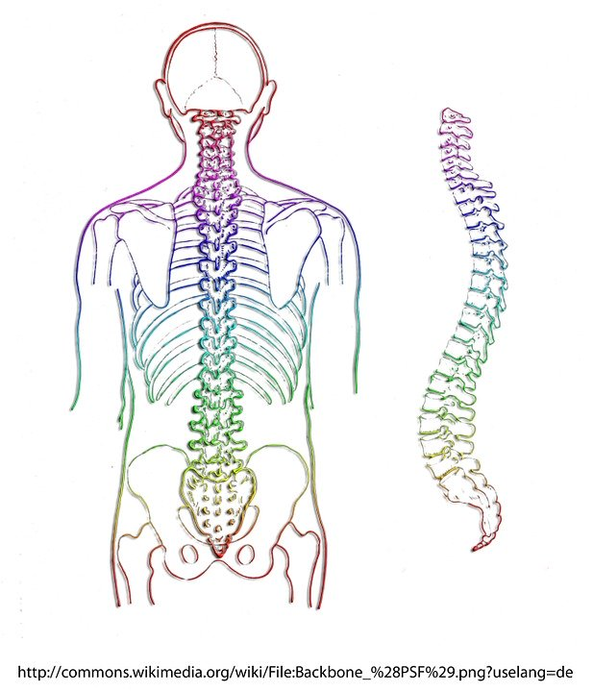
Pathogenesis - Associated Risk Factors
Unknown exact Pathophysiology
Histological Analysis of the microscopic lesions in the ligaments and the attachment sites to the bone(s) have illustrated Prominent Inflammatory Reactions followed by the erosion of the affected bone(s) (Ranatunga & Miller, 2014)
Biochemistry Findings tend to be *HLA-B27 Positive Among the Majority of AS patients (Carmen Stolwijk et al., 2012; Edward F. Goljan, MD, 2019; Hopkinsarthritis.org, 2020)
*HLA = The major Histocompability complex class 1 Antigen
Notes:
Turning our attention towards the underlying cause of the disease, the exact etiology is still unknown. Nevertheless, prominent inflammatory reactions have been illustrated in the affected joints followed by their erosion.
And in terms of Biochemical laboratory findings, the majority of the patients tend to be HLA-B27 positive.

Slide 5
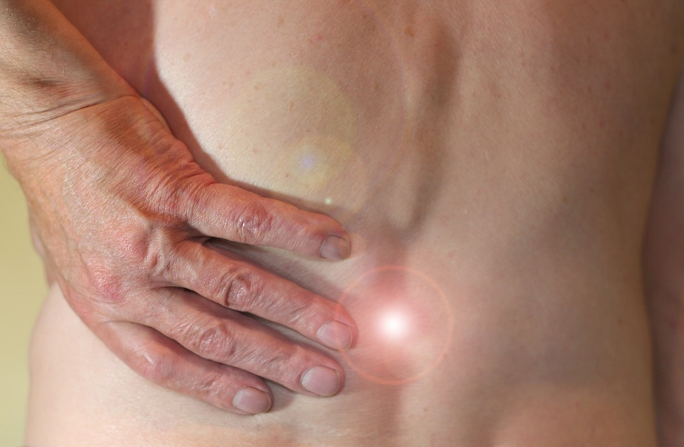
AS - Diagnosis
Chief Complaints: Morning Stiffness, Lower Back Pain over than three months which Improves with Exercise)
Diagnosis based on The New York Diagnostic Criteria:
At least ONE Radiological Finding (e.g. ‘bilateral sacroiliitis grade ≥ 2, or unilateral sacroiliitis grade 3 to 4’)
One Clinical Criterion (i.e. ‘Lower Back Pain and Morning stiffness over than three months which improves by Physical Activity, limited forward and lateral motion of the spine’) (Spondylitis Association of America, 2020; Ranatunga & Miller, 2014)
Can be associated with Extra- Articular, Multi-Systemic manifestations (i.e. involvement of the liver)
Notes:
As far as the disease’s Diagnosis is concerned, as the routine, it is diagnosed in combination of at least one clinical criterion based on the patient’s Chief Complaints, such as, morning stiffness and lower back pain which gets alleviated by exercise, combined with clinical findings based on the New York Diagnostic Criteria which is at least one radiological finding in the affected joint. However, over time, the disease can also manifest in the other joints.

Slide 6

Ankylosing Spondylitis (AS) - Management
Therapeutic Agents:
Analgesics (i.e. ‘NonSteroidal Anti-Inflammatory Drugs – NSAIDs’)
“ Disease Modifying Anti-Rheumatic Drugs” (“DMARDs”) - adjunctive administration of certain analgesics/anti-inflammatory drugs with some other drugs (e.g. Methotrexate, Steroids) (Edward F. Goljan, MD, 2019)
Surgery (e.g. Hip Surgery) is considered as the beneficial treatment option for some patients
Physical Activity - Implementing certain Physical Activities (e.g. Stretching Exercise)
Notes:
In terms of the management of disease, traditionally, it has been managed by pain killers (such as NSAIDs) as solo or in combination with some other drugs (e.g. Methotrexate) , which are then named as DMARDS.
Also, in some cases, the patient may benefit from surgery. Nevertheless, Studies have illustrated that Physical Activities can also have a promising effect on its alleviation and the course of its progression. And such association is going to be illustrated more closely in the following slides.

Slide 7

The Canadian Spondylitis Association – Spondylitis Study
The CSA Study – Wellness
Initially 840 Patients
In Total 535 Responses
Both Men and Women
Aged 18 – Over 65 (3 under
age 18)
Different Geographic –
Mainly from Canada
Notes:
So now, moving on to the study and the wellness related findings, to begin with, the study was conducted by the Canadian Spondylitis Association and among 840 patients. However, the obtained data are based on 535 responses from both men and women with different origins, but mainly based in Canada and were mainly aged from 18 and over 65.

Slide 8

Data Analysis Approach – Wellness
Analyzing Patients’ Wellness (the Physical and Psychological impacts of the disease), based on:
* BASFI: Patients mobility level by using 10 standard questions - Functional Anatomy (putting socks, bending, reaching, changing position, standing, turning, climbing steps, looking over the shoulder, and TWO items assessing the patients’ ability to cope with everyday life)
The "Diagnostic and Statistical Manual of Mental Disorders – 5” (DSM5):
Depressive Disorder, Anxiety, Sleep Disorder, Somatic Symptoms (e.g. Fatigue), and so forth
*BASFI = ‘The Bath Ankylosing Spondylitis Functional Index’
Notes:
Furthermore, in terms of data analyzing approach for the patients’ wellness, the analysis was based on: i) defining the wellness in terms of Physical and Psychological, and ii) the criteria for categorizing them based upon the standard guidelines, BASFI for the Physical Wellness and DSM5 for the Psychological one.
In light of this, the answers were categorised under each of this categories.

Slide 9
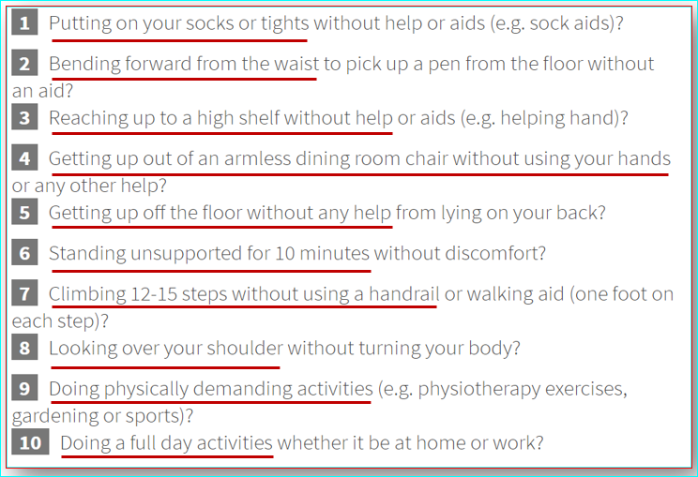


Data Analysis Approach – Physical Wellness
Mobility and “Bath Ankylosing Spondylitis Functional Index”(BASFI)
Meta-Analysis studies - average Score of the overlapped questions/Answers (e.g. “having restriction to put shoes on” (Q98) versus “to try shoes”(Q97)
Table 1. Table illustrating BASFI questions, MDAPP (2020)
Notes:
So, for the Physical Wellness related responses, all the responses associated with BASFI questionnaires and measurement were located under the relevant order. Nevertheless, to avoid confounding bias, the meta-analysis approach was used for the repetitive questions and answers.

Slide 10
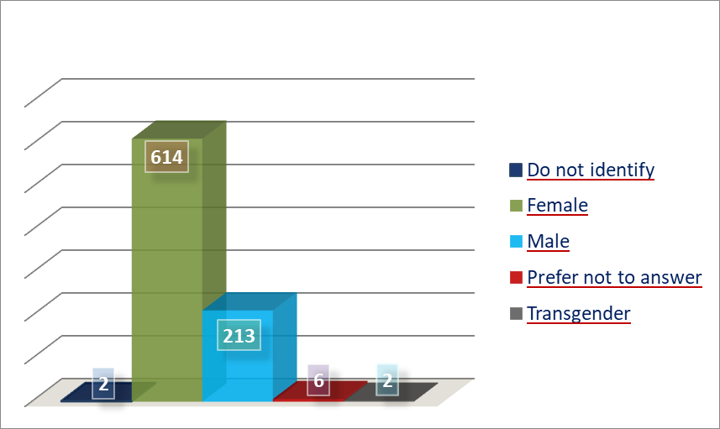
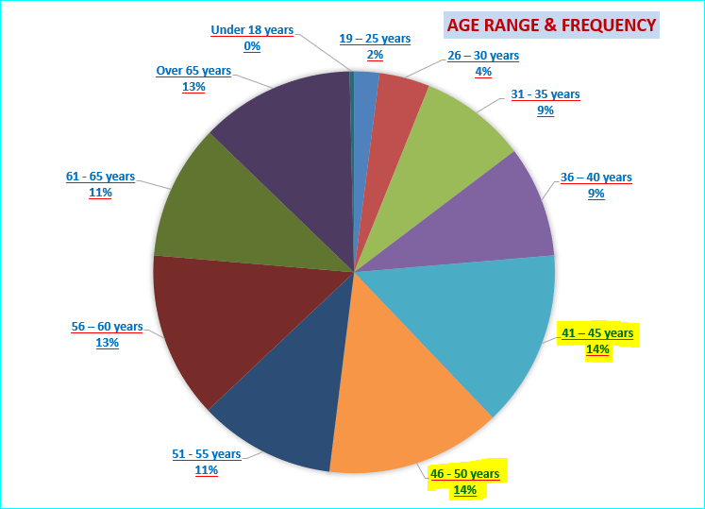

Demographics
Gender Frequency
614 Female (73.2%)
213 Male (25.4%)
6 Preferred not to say
2 Transgender
The majority aged between 41 - 50
Notes:
So, demographically speaking, it showed that the majority (73%) of the responses came from females, followed by men (about 25%). Additionally, the majority of ALL responses were aged between 40 to 50.

Slide 11
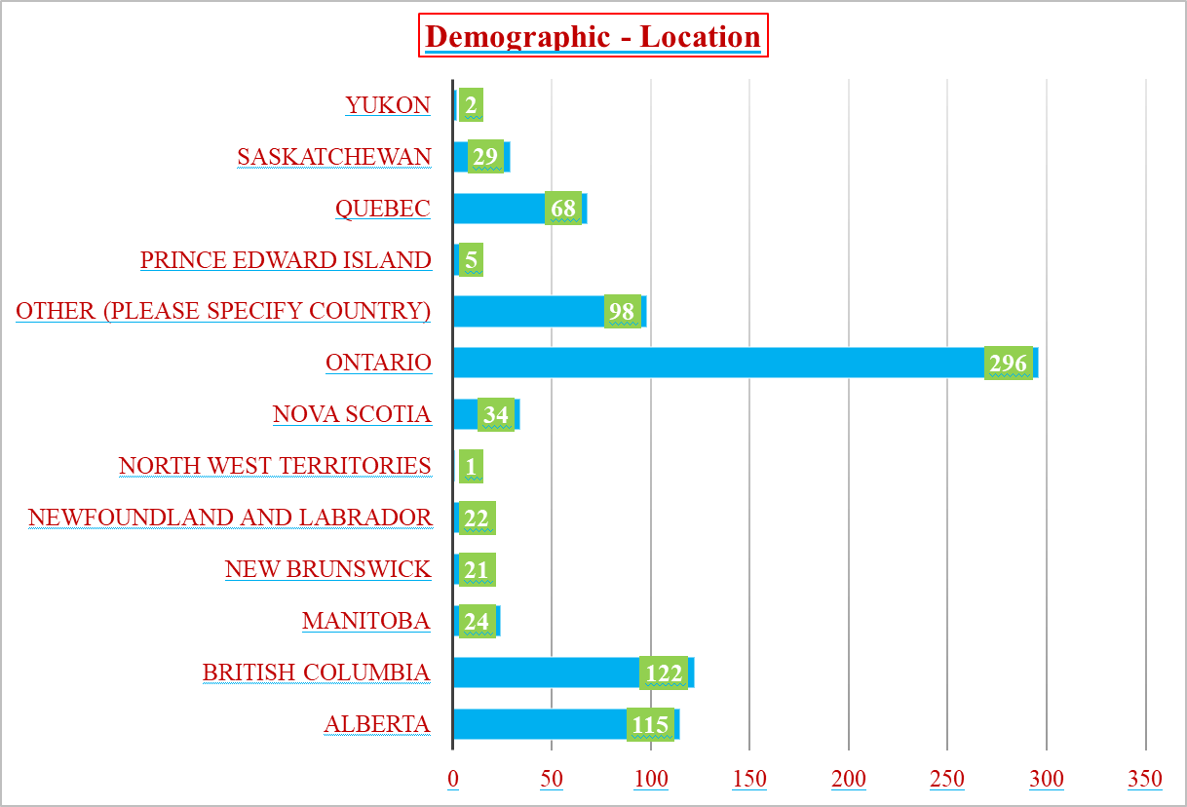
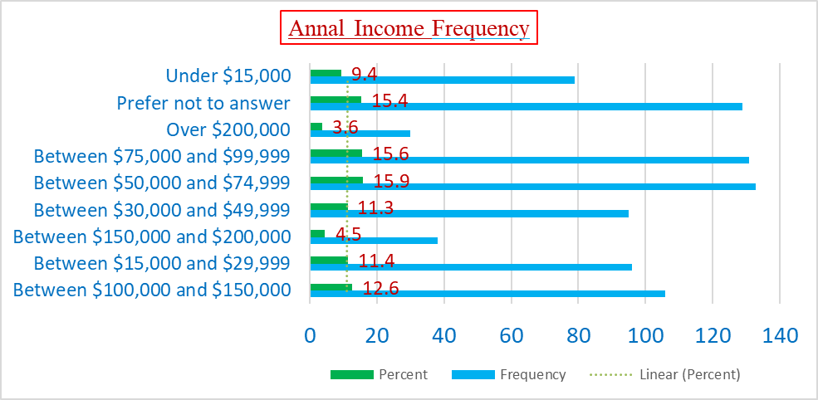
Demographics
296 – From Ontario
122 - From BC
115 - From Alberta
The majority had Annual Household Income between $50,000 - $74,9999
Notes:
Furthermore, it showed that the majority of the participants were based in Ontario, followed by BC and Alberta.
And also, the majority of them had an annual household income between $50,000 - $75,000

Slide 12
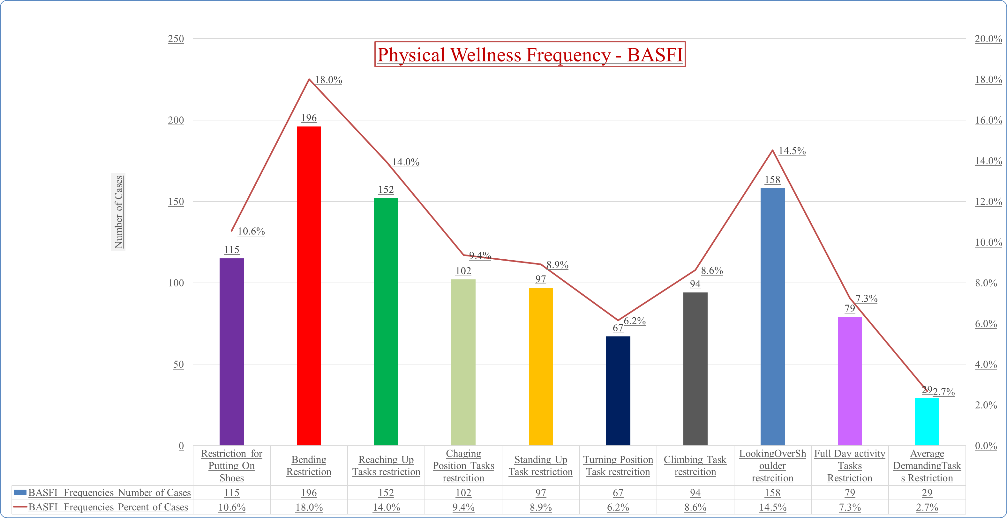
Physical Wellness – BASFI Frequencies
18.0% had Bending Restriction
14.5% had Looking Over
the Shoulder Restriction
14.0% had Reaching Up Tasks
Restriction
Notes:
65.4% Missing Cases, 34.6% Valid Cases
Also, the BASFI analysis illustrated that the majority of cases (18%) had bending restriction, followed by looking over the shoulder (14.5%) and reaching up tasks restriction (14.0%)

Slide 13
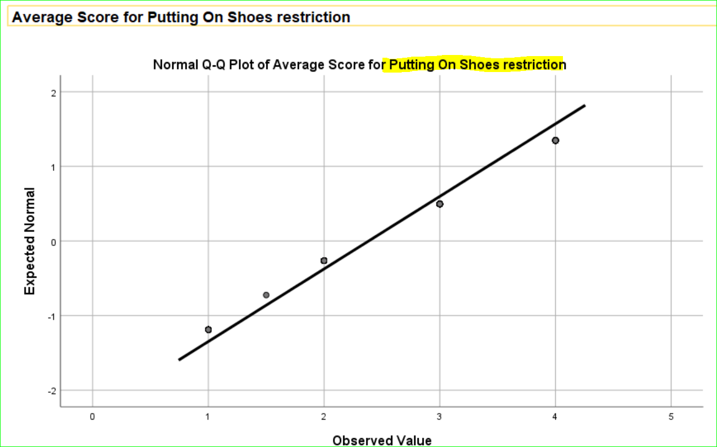
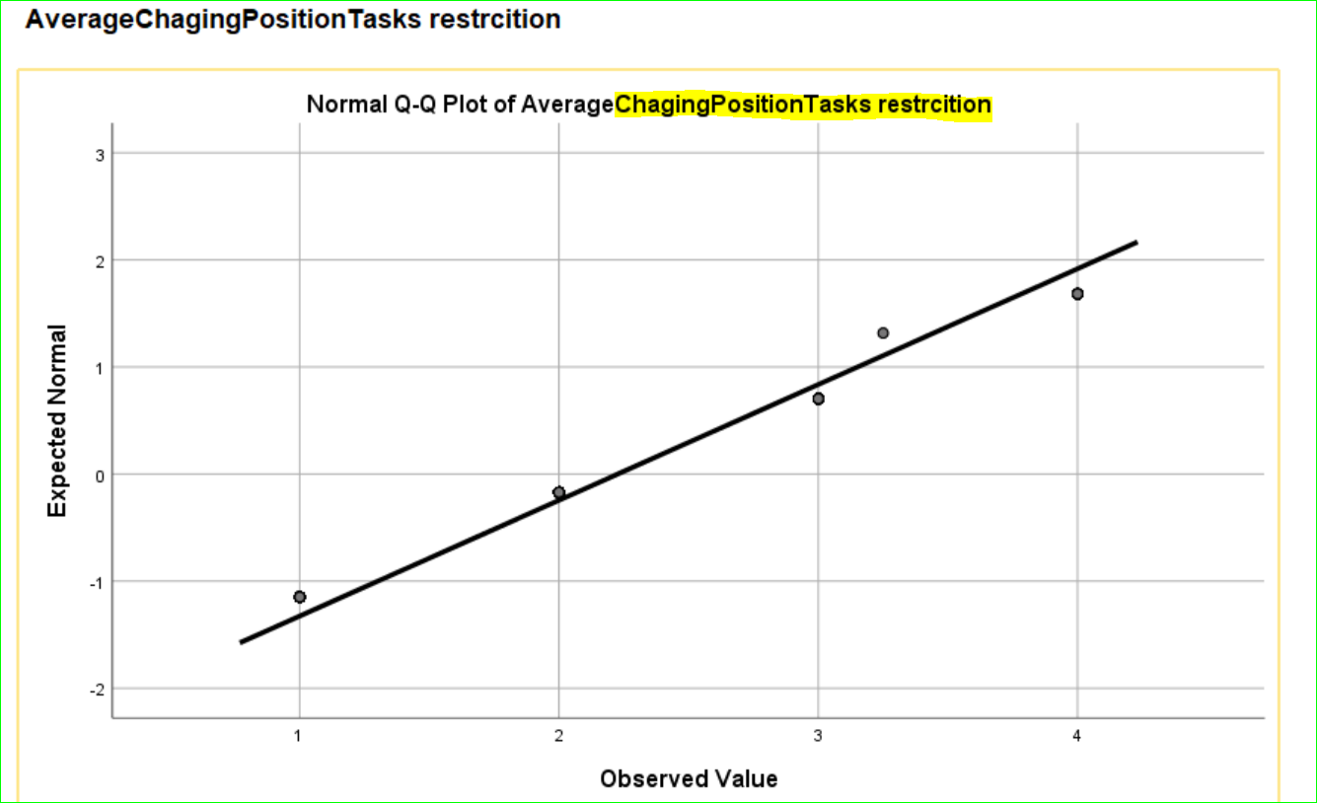
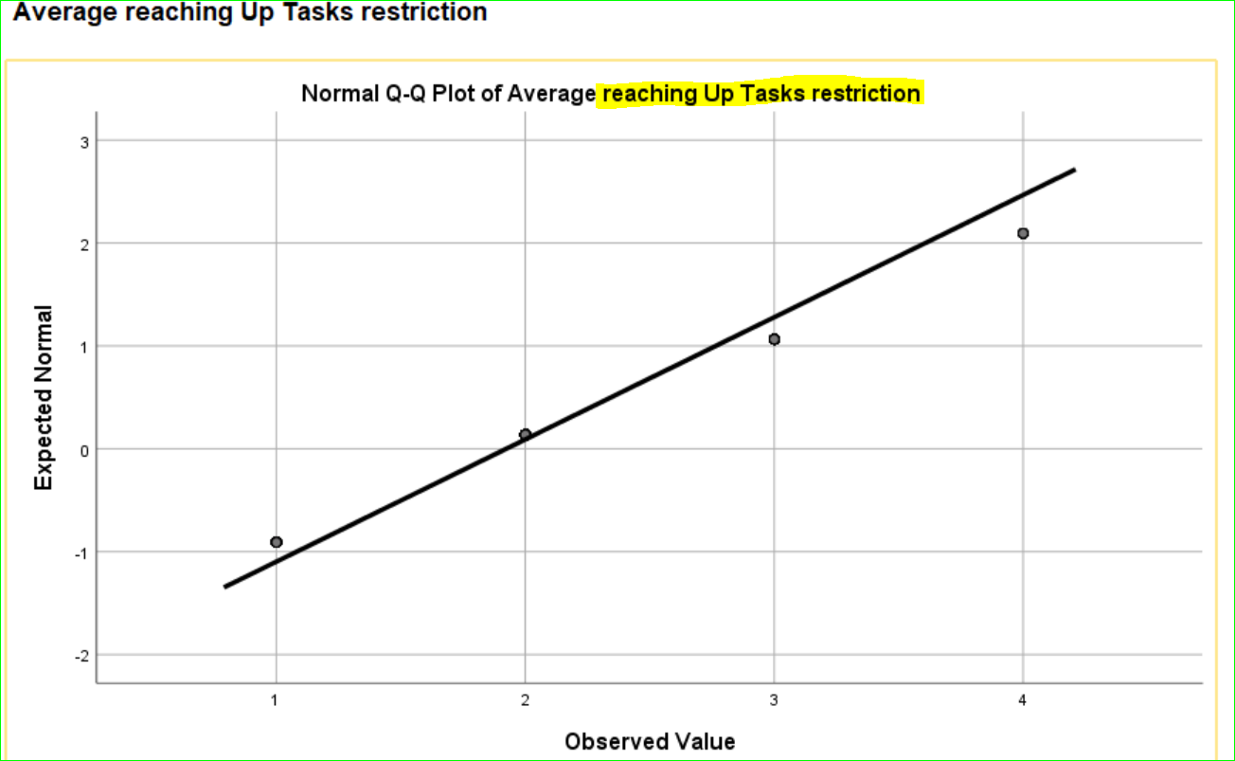
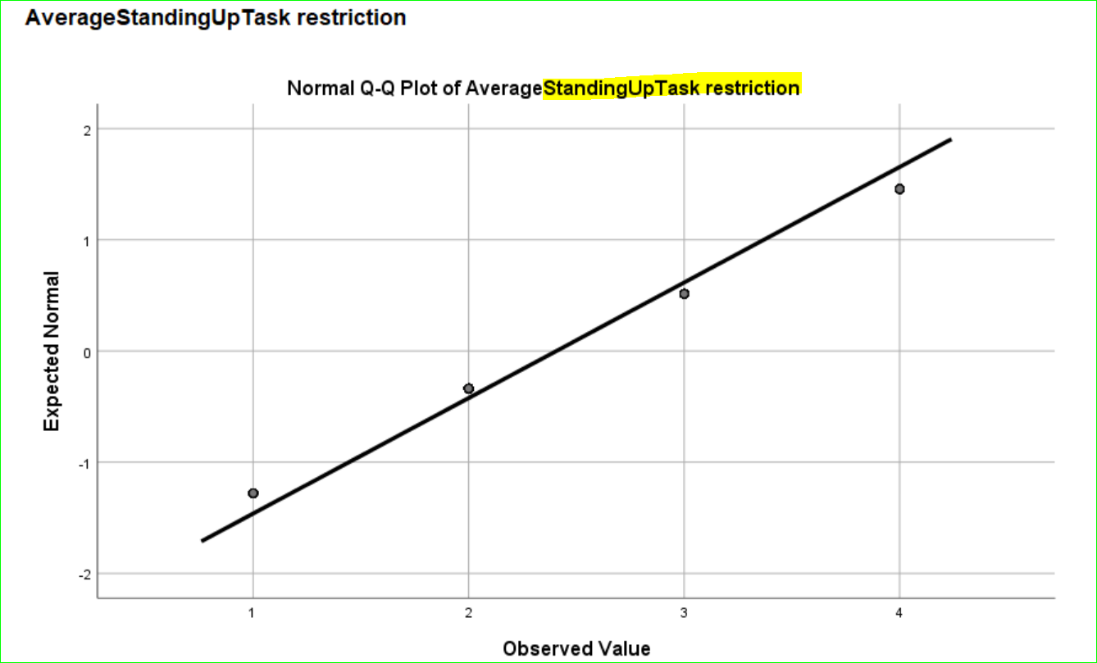
Correlation Analysis – BASFI & Tasks' Restriction
Positive Correlation Between Tasks Restriction & BASFI Measurements
Notes:
The correlation analysis between BASFI Scores and Tasks Restrictions was something that was conducted out of curiosity and to assess the validity of the BASFI-based approach for this presentation. And interestingly, it showed that there is strong correlation between the BASFI measurements and patients’ mobility restrictions.

Slide 14
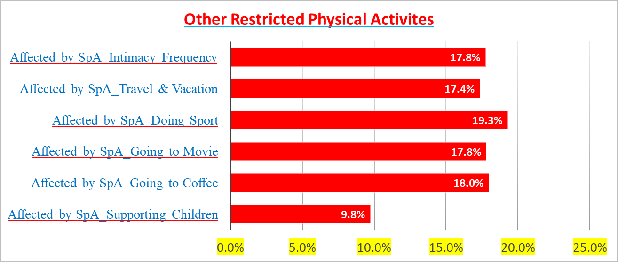
Physical Wellness – Other Restricted Activities
19.3% of the patients were Restricted Doing Sport
The Majority were Restricted other activities in their private and social life (e.g. intimacy, vacation)
Notes:
Additionally, other than BASFI-related Physical Activity Restrictions, about 19.3% of the patients were restricted in doing other physical activities, such as sport .

Slide 15
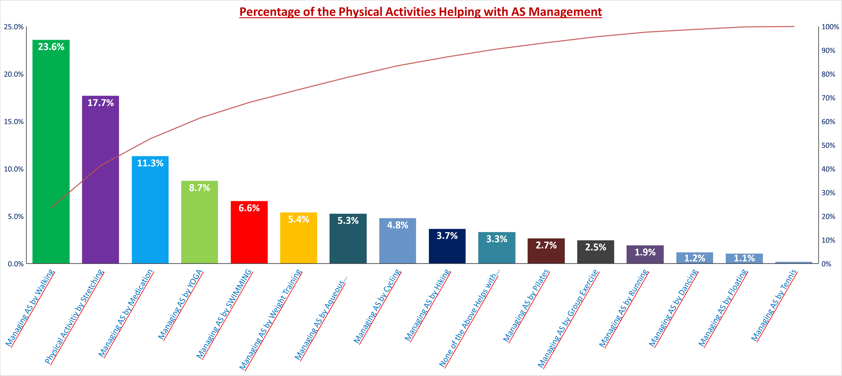
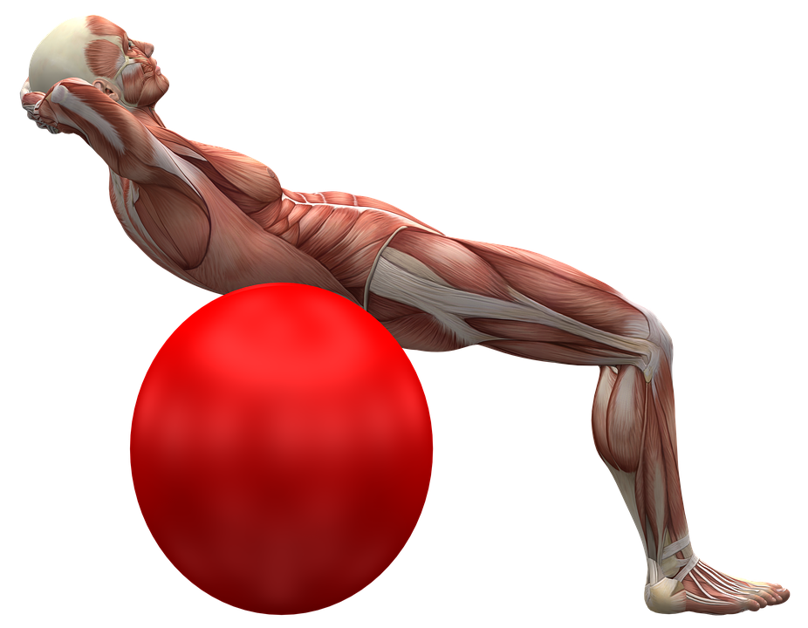
Wellness – Managing AS by EXCERCISE
23.6% – Managed their Disease by Walking
In TOTAL 29% - Managed their AS by
Stretching Exercises (e.g. Yoga, Pilates)
Notes:
Interestingly, it appeared that the majority of the participants, tend to either walk or doing stretching exercises (e.g. yoga and Pilates) to alleviate the symptoms.

Slide 16
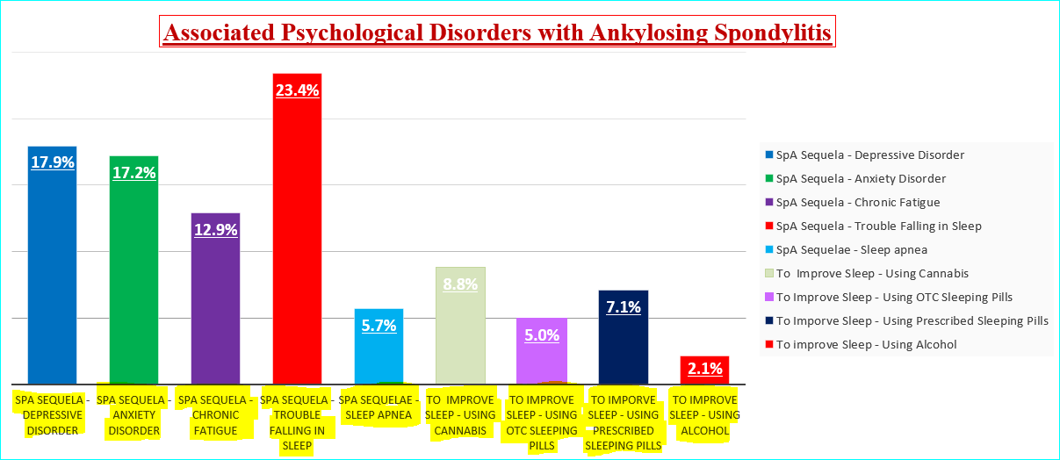

Psychological Wellness – DSM5 Approach
23.4% - Trouble Falling in Sleep
17.9% - Depressive Disorder
17.2% - Anxiety Disorder
Notes:
So now, turning our attention towards the Psychological Wellness analysis and findings, the study showed that falling in sleep was the prominent issue among the majority of the patients, followed by having depression and anxiety.

Slide 17
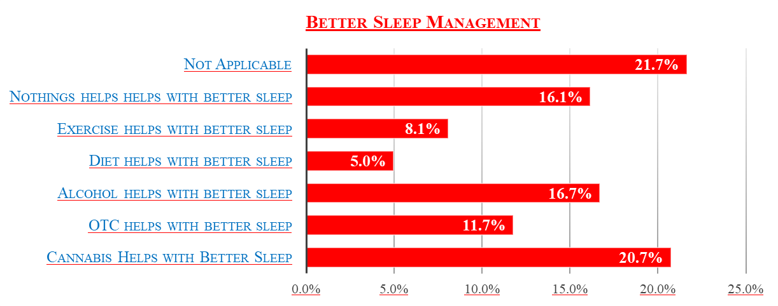


Sleep Management
21.7% - Nothing Helped
20.7% - Cannabis Helped
16.7% - Alcohol Helped with their sleep
Notes:
Also, in terms what could improve their sleep, 21.7% said nothing would help, whereas, 20.7% and 16.7% found Cannabis and alcohol respectively helpful.

Slide 18
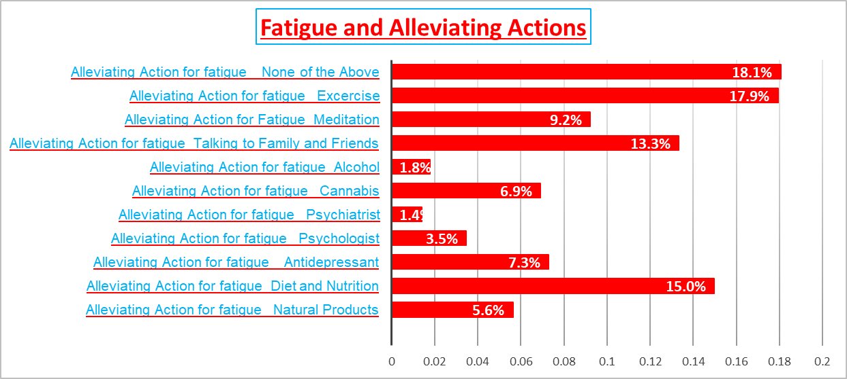
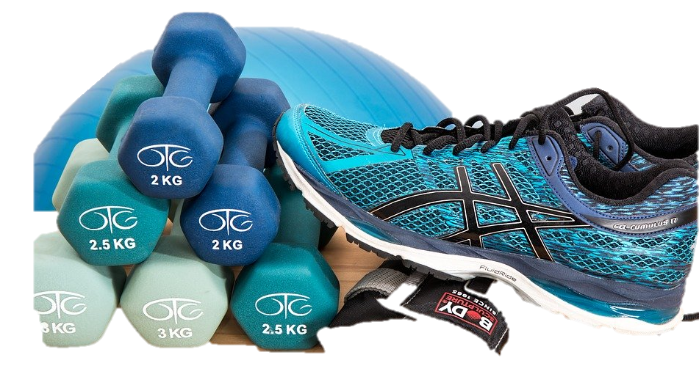
Wellness – Managing Fatigue
18.1% - None of the options helps with patients’ fatigue
17.9% - Exercise improves fatigue
Notes:
Additionally, as far as managing fatigue was concerned – in terms of the somatic manifestation of the disease – it appeared that almost the majority of the patients did not find anything to help them or found exercise to be helpful.

Slide 19
Discussion AND Conclusion
 Confounding Bias - some repetitive questions and their
implication in the validity of the data
 The onset of the disease tends to be before age 45 and in
this study the majority of the patients were aged between 41-50
 Physical Activity - Wellness Implications
 Replication of the findings for the prospective studies - Further
Observational or Hypothesis Testing – Health Promotion
Notes:
So, considering the fact that the study was not designed by us, one would argue certain limitations which could potentially affect the interpretation of the collected responses and findings. For instance, confounding bias (e.g. we do not know what other pre-existing medical conditions the patients had as such factors impact their overall health, their response, and ultimately presented findings.
Nevertheless, overall, the findings in this study correlate with the majorities of literatures, such as, in terms of the onset of the disease, the benefits of physical activities in improving patient's wellness. Altogether, the findings have the potential for being used for other studies or any Health promotion activities.

Slide 20
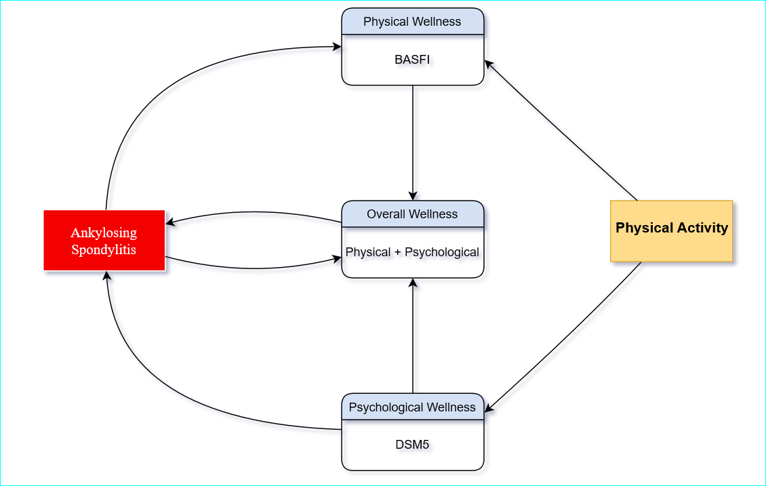
Summary
The Majority of the Patients Managed their Disease by Physical activities (i.e. Walking, Stretching Exercise)
Mobility Restriction
Therapeutics
Psychological Disorders Affecting Patient’s Life Quality - Worsening the Disease
Among 17.9% of the patients, EXCERCISE improved their FATIGUE
Notes:
As summary, the message in the presentation is that the disease has negative implications in Physical and Psychological wellness of the patient. And historically, therapeutics have been used to manage the disease and alleviate the physical and psychological symptoms. Nevertheless, depending on their dose, their chronic use can potentially lead to serious side effects (E.g. hepatic insufficiency). Therefore, the findings in this study can be inferred that there should be balance between using drugs and physical activities as they seem to alleviate the symptoms.

Slide 21
References
American Psychiatric Association. (2013). Desk Reference to the Diagnostic Criteria From DSM-5®—American Psychiatric Association—Google Books. Retrieved February 27, 2020, from https://books.google.ca/books?hl=en&lr=&id=QpmvBAAAQBAJ&oi=fnd&pg=PT7&dq=dsm+5+diagnostic+Criteria+and+codes&ots=MM3eOJPsS1&sig=hWA5e3dv_FAu3S7sMIu1KYiSGZE&redir_esc=y#v=onepage&q=dsm%205%20diagnostic%20Criteria%20and%20codes&f=false
Basdai.com. (2005). Bath Ankylosing Spondylitis Functional Index (BASFI) Test. Retrieved February 24, 2020, from http://basdai.com/BASFI.php
CSA. (2020). Canadian Spondylitis Association | Support & Advocacy | Homepage. Retrieved March 10, 2020, from https://www.spondylitis.ca/
Carmen Stolwijk et al. (2012). Epidemiology of Spondyloarthritis | Elsevier Enhanced Reader. Retrieved February 7, 2020, from https://reader.elsevier.com/reader/sd/pii/S0889857X12000816?token=C7C464DE621D4667BD95B1FA7CFCEA5154D04E742CB3D2F5BCDBAB24A112C069D215DB1BD37256AF963F0E9BA8B33947
Edward F. Goljan, MD. (2019). Elsevier: Rapid Review Pathology, 5th Edition: Goljan. Retrieved February 7, 2020, from https://www.elsevier.ca/ca/product.jsp?isbn=9780323476683
Hopkinsarthritis.org. (2020). Ankylosing Spondylitis: Symptoms, Diagnosis and Treatment. Retrieved February 7, 2020, from https://www.hopkinsarthritis.org/arthritis-info/ankylosing-spondylitis/
IBM Knowledge Center. (2020). IBM SPSS. Retrieved February 27, 2020, from https://www.ibm.com/support/knowledgecenter/en/SSLVMB_26.0.0/statistics_mainhelp_ddita/spss/base/overvw_auto_0.html
MDAPP. (2020). Bath Ankylosing Spondylitis Functional Index (BASFI) Calculator. Retrieved March 7, 2020, from MDApp website: https://www.mdapp.co/bath-ankylosing-spondylitis-functional-index-basfi-calculator-230/
Ranatunga, S., & Miller, A. (2014). Active axial spondyloarthritis: Potential role of certolizumab pegol. Therapeutics and Clinical Risk Management, 10, 87–94. https://doi.org/10.2147/TCRM.S53675
Spondylitis Association of America. (2020). Classification of Spondyloarthritis. Retrieved February 8, 2020, from Spondylitis Association of America website: https://www.spondylitis.org/About-SAA/Updates/classification-of-spondyloarthritis

Slide 22

Notes:
And the average scores were put into SPSS for Descriptive analysis purposes – just for BASFI part of the study – Next, the variables were recoded, as shown in this slide.
Also, the analysis was performed by taking into the account that there were 305 cases with no response – as they would affect certain elements of the descriptive statistics.
Moreover, there was used an average scoring system for illustrating the severity of each element of the BASFI, as shown in below:
Scoring Values 1 = “No Restriction, 2 = “Low’, 3 = “Medium”, 4 = “High, 8 = “Not Applicable” (8 was labeled as NULL (0) for calculation purposes
Scoring Range: <1: No mobility restriction
1-2: Very low mobility restriction
2-3: Low to medium mobility restriction
3-4: Medium to High Mobility Restriction

